Slide 1
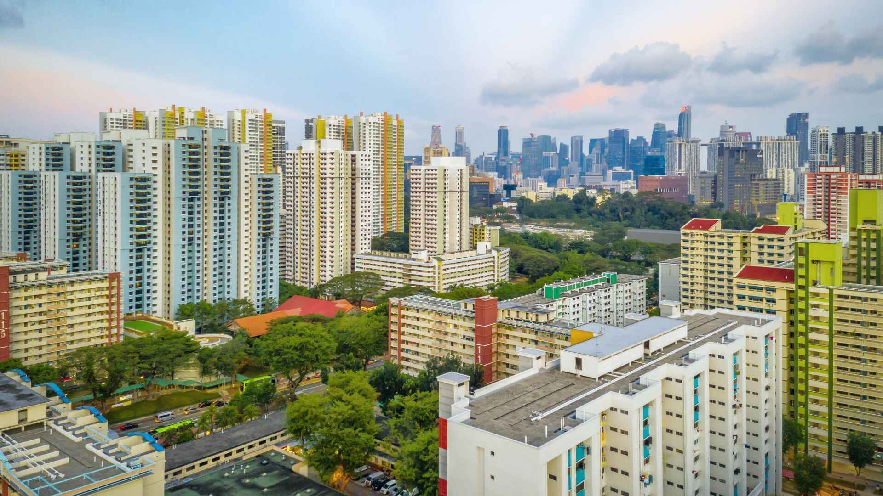
HDB RESALE ANALYSIS
Capstone Project
HDB RESALE ANALYSIS

Slide 2








HDB RESALE ANALYSIS
HDB RESALE PRICE ANALYSIS
This project explores the trends and factors influencing HDB (Housing Development Board) resale prices in Singapore. By analyzing historical data, we'll uncover insights to help homebuyers and investors make informed decisions in the HDB resale market.
Research Objective Takeaway Keywords:
Resale Trend Over years and uncover more about future Using Forecast AI
Offers Valuable insights for Property market stakeholders by the resale price index values over the years
Hierarchical distribution of Resale Prices across Regions, Towns, Blocks and so on.
Interactive Map to help to find out nearest MRT, school, mall and latest Highest Resale Price of the Blk.
HDB resale prices and sales volumes from 2012 to 2024, highlighting key factors influencing these metrics.
For Investors to get Latest resale prices over the years with Nearest Amenities values.
Overview of HDB resale transactions, showcasing the total transaction value and key statistics and transaction volumes across different towns.
Multivariate clustering analysis performed using machine learning techniques in Power BI.

Slide 3
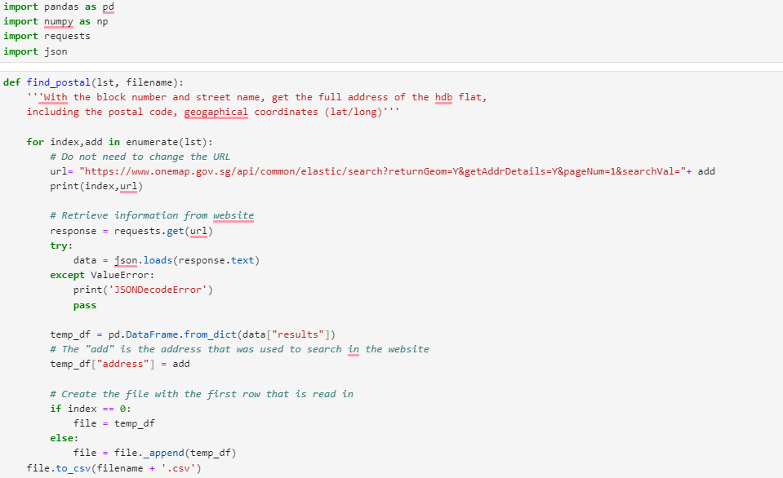
HDB RESALE ANALYSIS
Data Extracting
Data Sets:
Total 5 Data Sets Used
1. HDB Resale Data Set from year 2012 – 2019
Column Names: blk, flat_model, flat_type, floor_area sqm ,lease_commence_date, month, remaining_lease, resale_price, story_range, street_range, town, street_lat, street_lon,town_lat, town_lon
Other Data Source (data.gov.sg)(onemap.gov.sg) (flat amenities)
2. HDB Resale Data Set from year 2020-2024
Resale Data from data.gov.sg doesn’t have latitude and longitude data, Onemap api is used to retrieve latitude and longtitue data.

Slide 4
HDB RESALE ANALYSIS
Data Extracting
Data Sets:
3. Region and town
Column Names: Region , town
4. HDB Resale Price Index
Column Names: Year-Q, RPI
5. Flat Amenities (nearest MRT, School, Part, Mall with distance)
Column Names: Flat, near_school, near_school_dist, num_school, near_hawker, near_hawker_dist, near_mall, near_mall_dist, near_mrt, near_mrt_dist, distance_douby

Slide 5
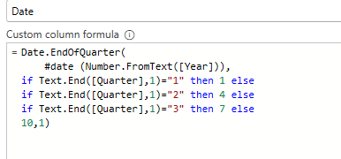
HDB RESALE ANALYSIS
Data Cleaning
HDB Data Set:
1. Created remaining lease year by Custom Column ([lease_commence_Date]+99)-[Year]
Year Column created by Column by Example of month Column
2. Created Address Column by Concatenating blk and street_name column
Address = [block] & “ “& [street_name]
HDB Resale Price Index:
Got Date data from Year (2012-Q1) to Date by following Steps
1. Extracted Year by using Column by Split
2. Created Date Column by formula

Slide 6
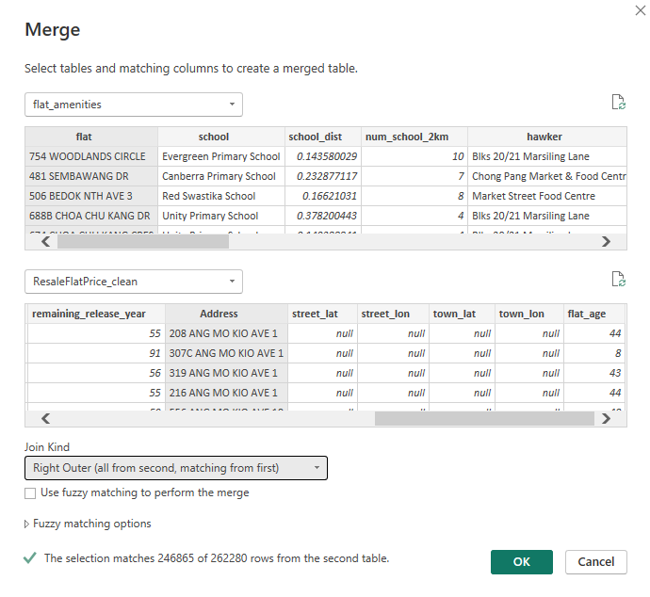
HDB RESALE ANALYSIS
Data Cleaning
Flat Amenities:
Flat_Amenities table and hdb_resale table doesn’t have common column to make relationship, so created address column in hdb_resale_date, Merged two table using RIGHT_OUTER_JOIN.

Slide 7
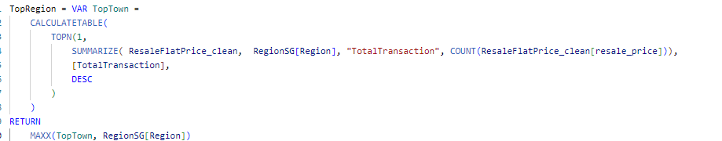
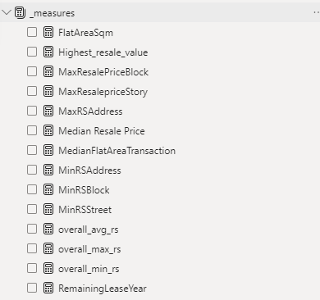
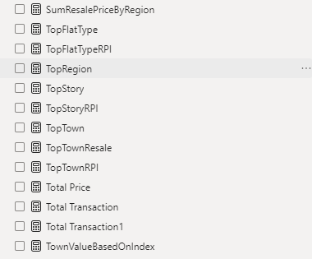
HDB RESALE ANALYSIS
Data Loading
25 Measures used:

Slide 8
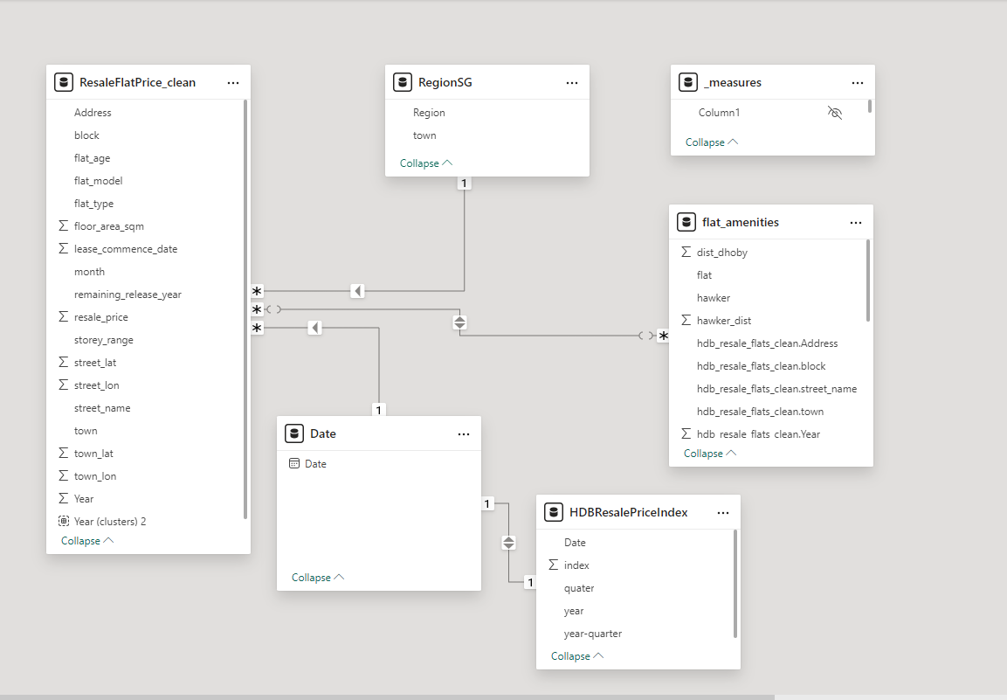
HDB RESALE ANALYSIS
Data Loading
Data Model
Date table by DAX. Date = CALENDAR(DATE(2012,1,1),DATE(2024,12,31))

Slide 9



Slide 10
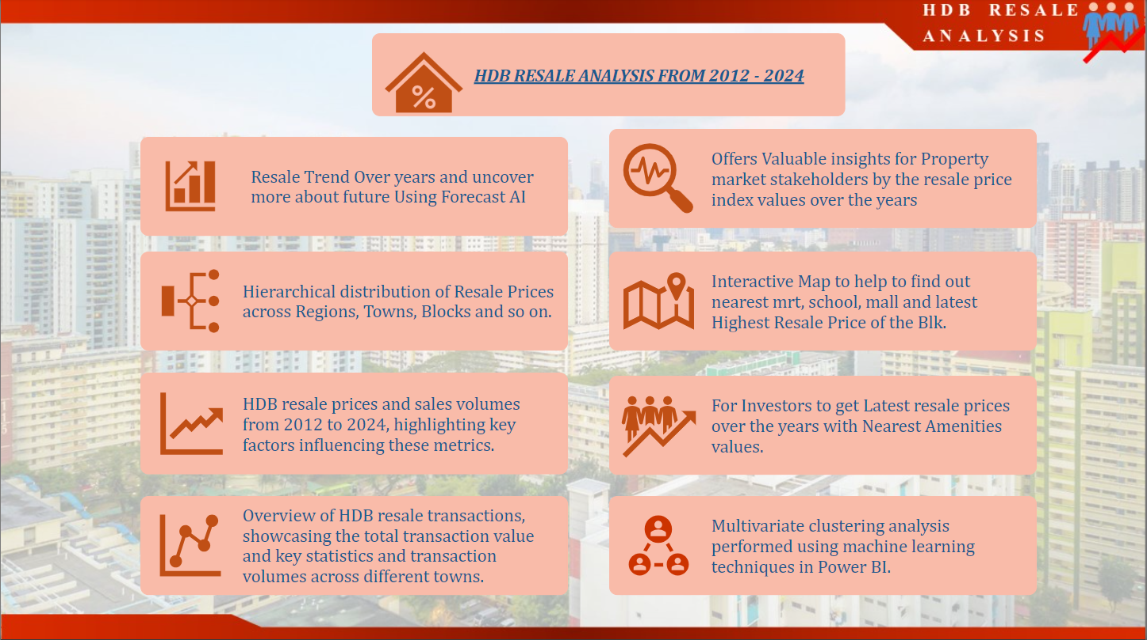
HDB RESALE ANALYSIS
Home Page

Slide 11
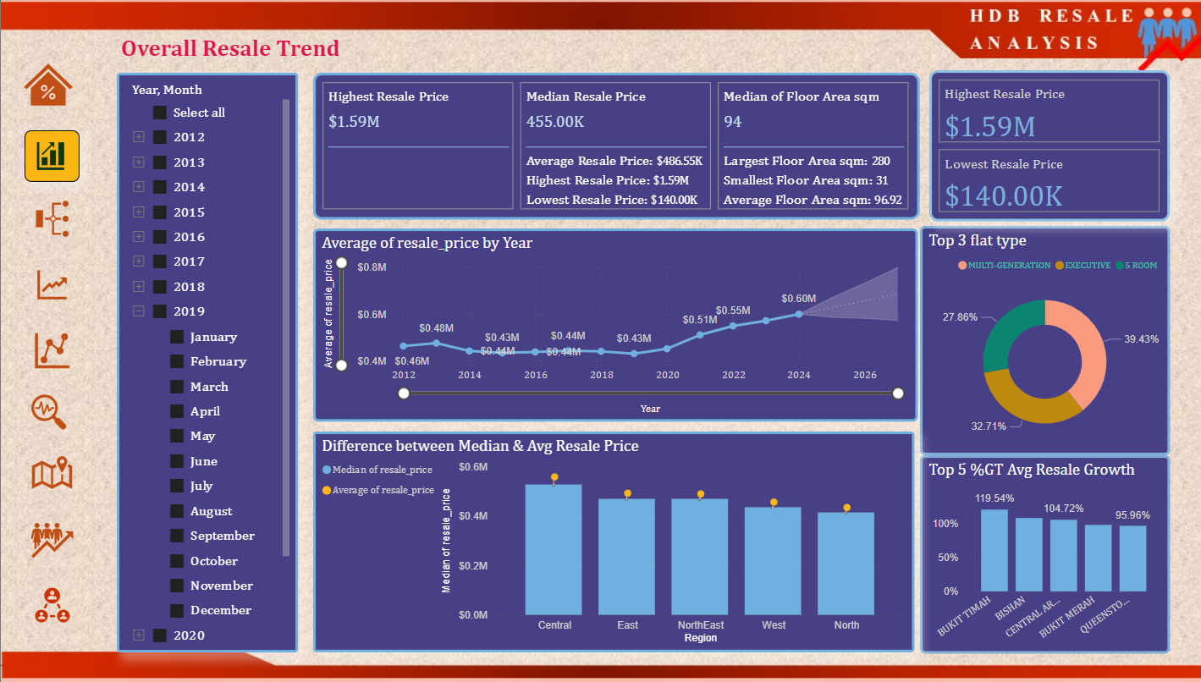
HDB RESALE ANALYSIS
Resale Trend Over the Year (2012-2024) uncover more about future using Forecast AI

Slide 12
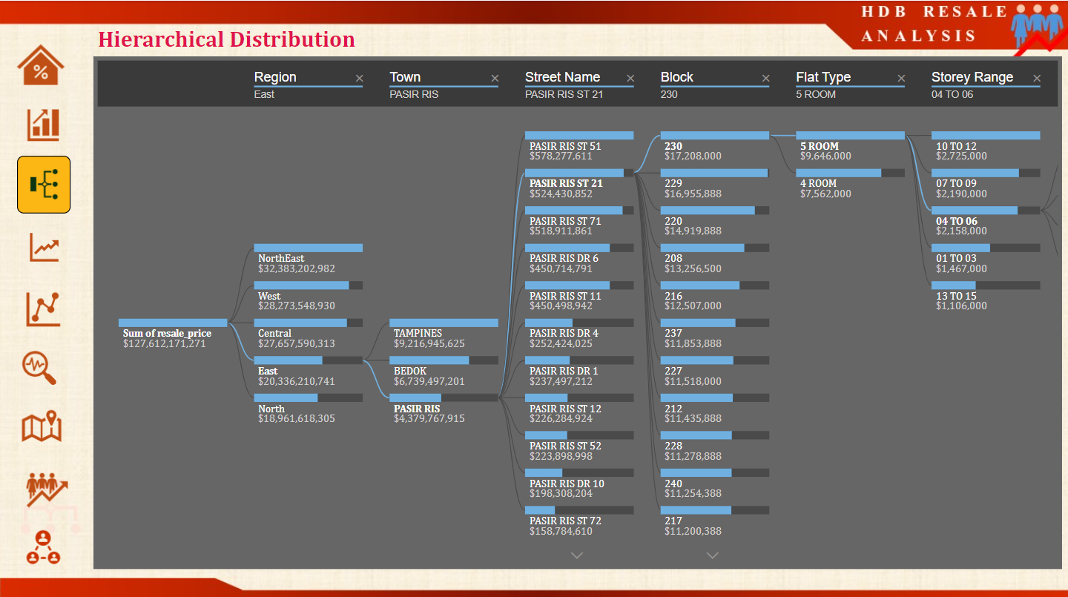
HDB RESALE ANALYSIS
Hierarchical Distribution of Resale Price across Region, Town..

Slide 13
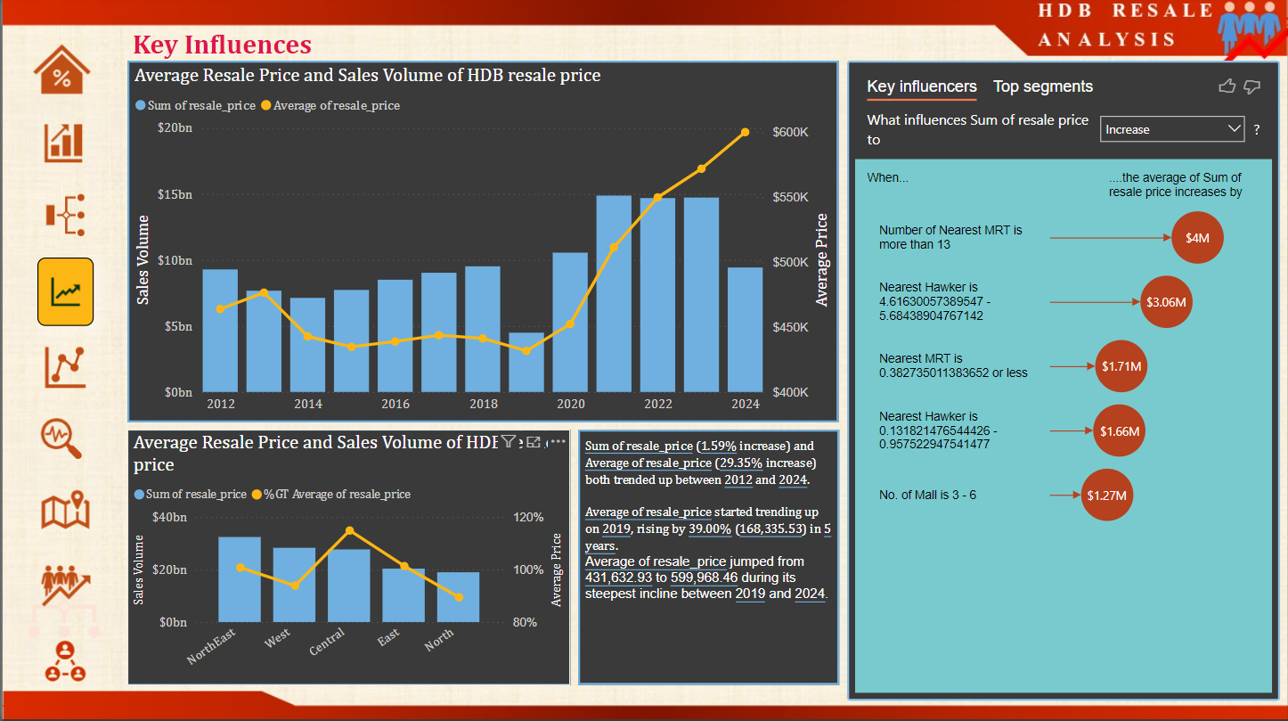
HDB RESALE ANALYSIS
Key factor influencing the Resale price

Slide 14
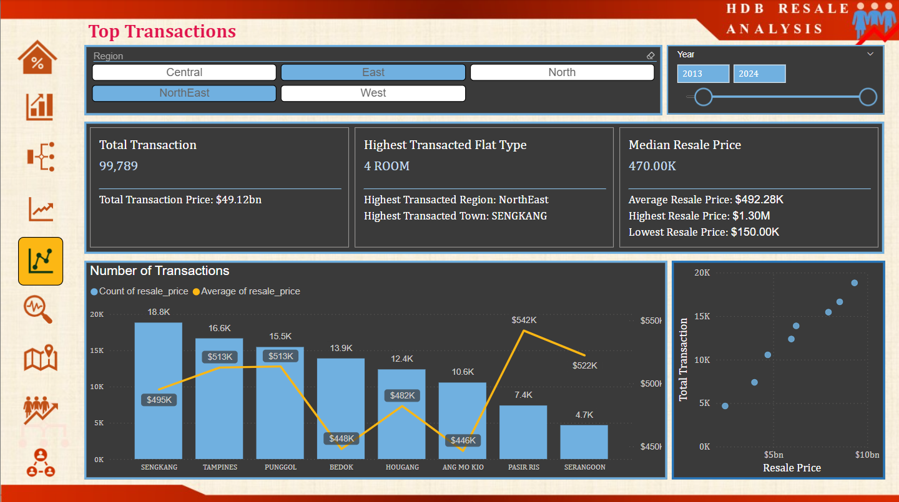
HDB RESALE ANALYSIS
Total Transactions across the Region and town , filtered by year

Slide 15
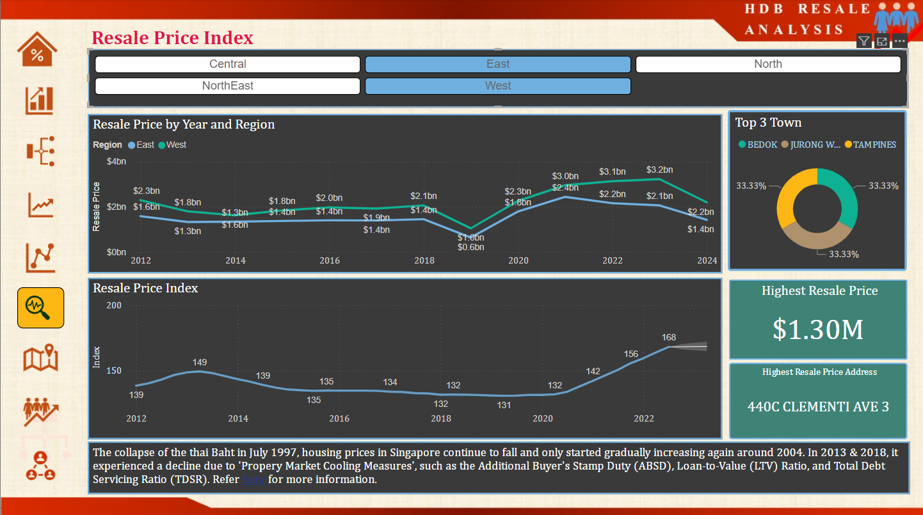
HDB RESALE ANALYSIS
Resale Price Index and Resale Price across the Region

Slide 16
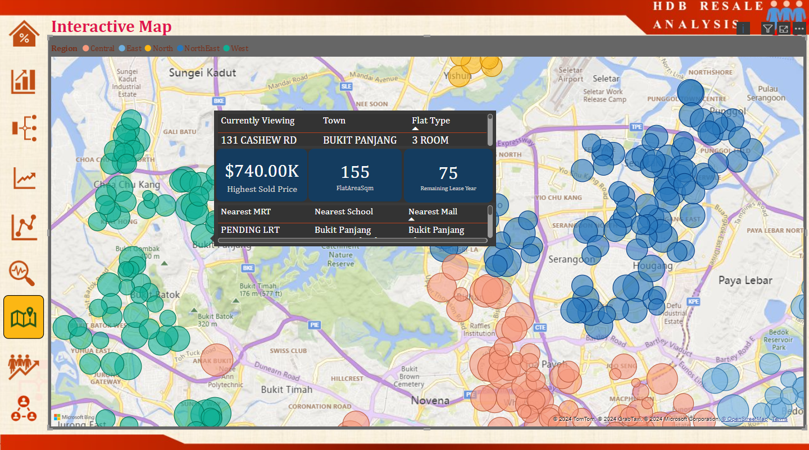
HDB RESALE ANALYSIS
Interactive Map to get details of Highest Sold Price, Nearest Amenities based on Address

Slide 17
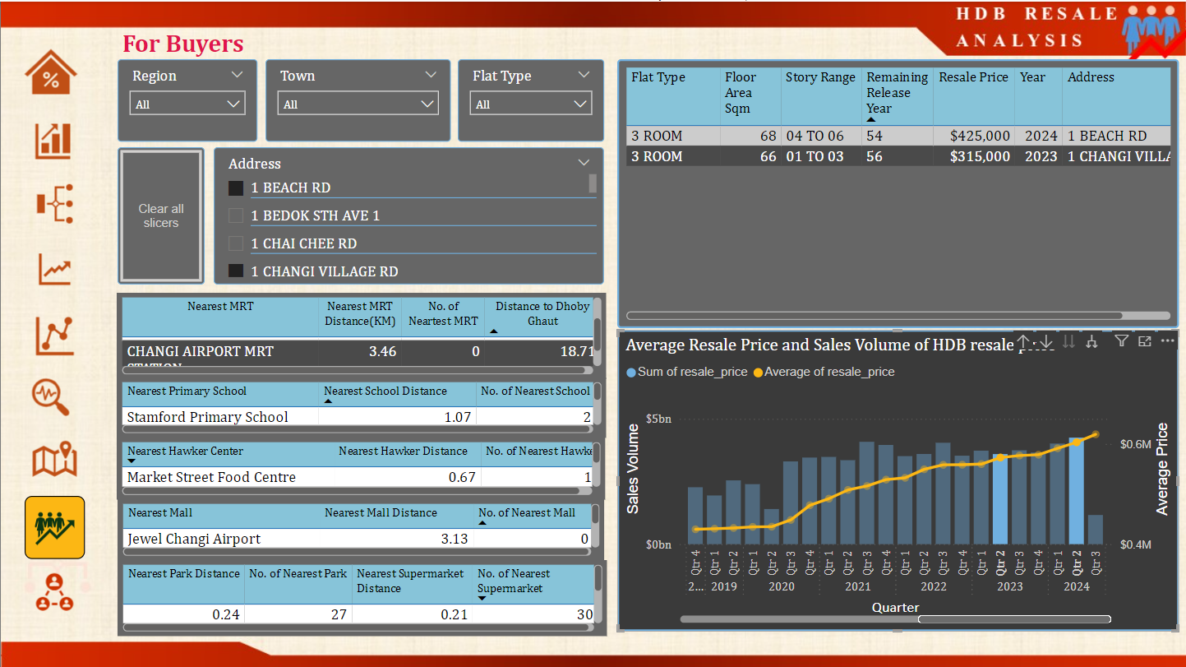
HDB RESALE ANALYSIS
For Buyer/Investors to Compare the resale price over the year with amenities details.

Slide 18
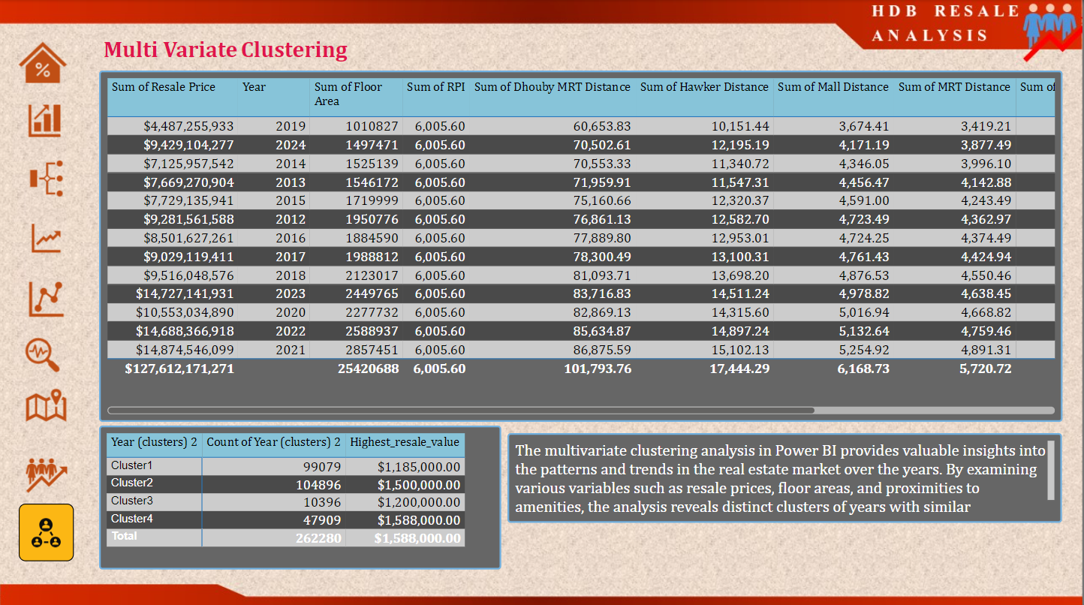
HDB RESALE ANALYSIS
Multivariant Clustering examining the patterns in the real estate market over the year.

Slide 19
HDB RESALE ANALYSIS
Thank you!

